Slide 1
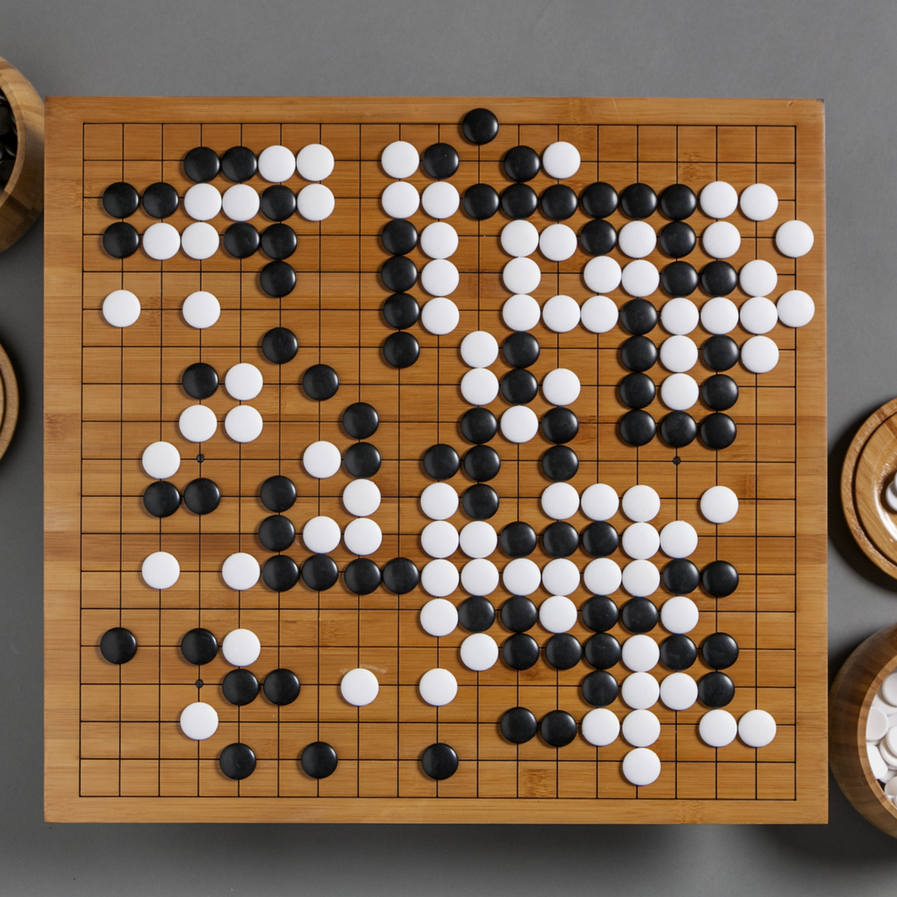
CSCI 599: ZeroGo
Solving the game of Go with ML
Sunny Patel
Jing Ouyang
Wesam Alwehaibi

Slide 2
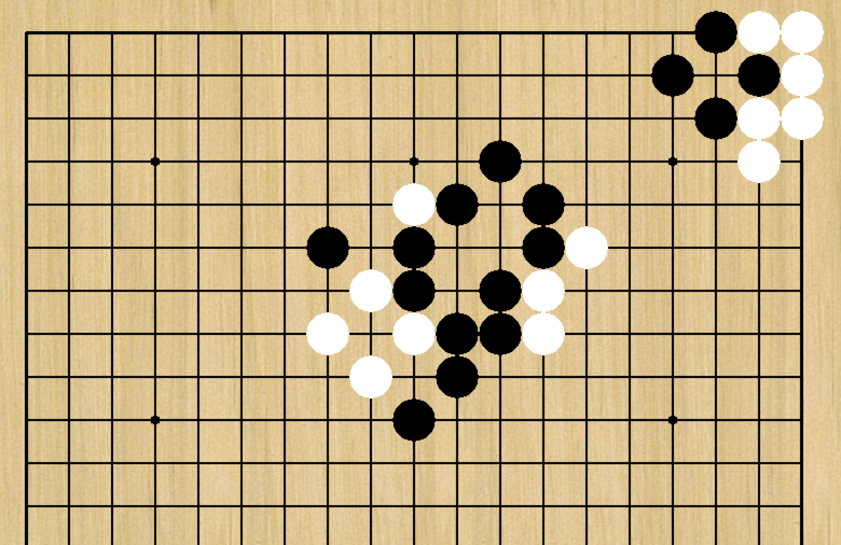
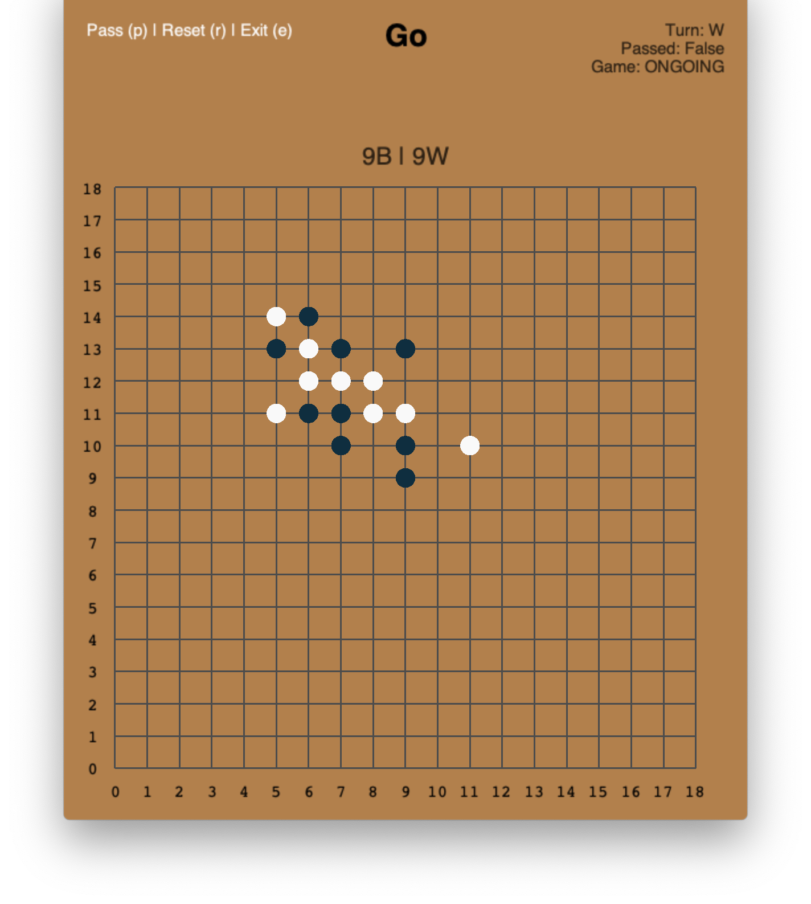
Week 4: What we did last week?
Research on UI tools that can help us build the Go Front end
GoBan GymGo

Slide 3
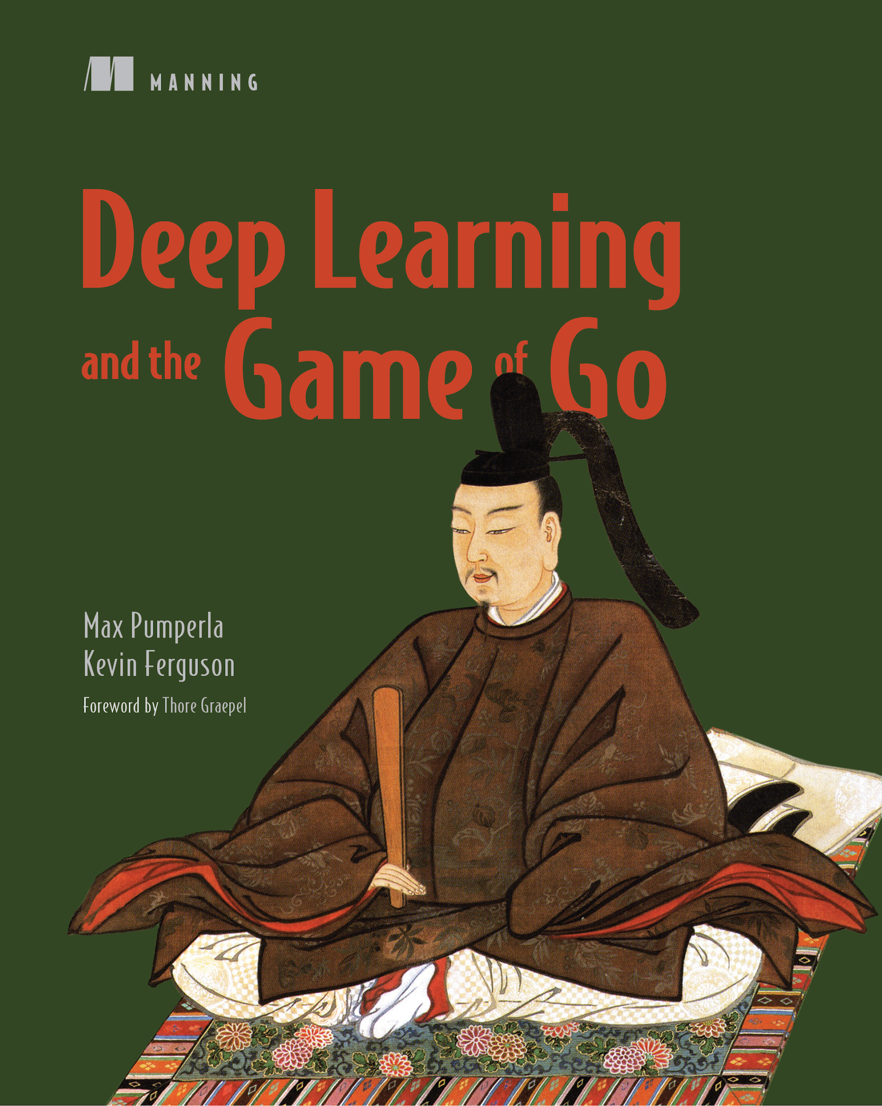
Week 4: What we did last week?
Started studying algorithms that can help

Slide 4
Week 4: Agents Developed
Random agent
Minimax agent
Depth-pruned agent
AlphaBeta agent
MCTS agent

Slide 5
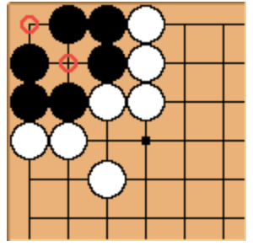
Random agent
Randomly select a valid action
Don’t fill in its own eye
Example of two-eyes

Slide 6
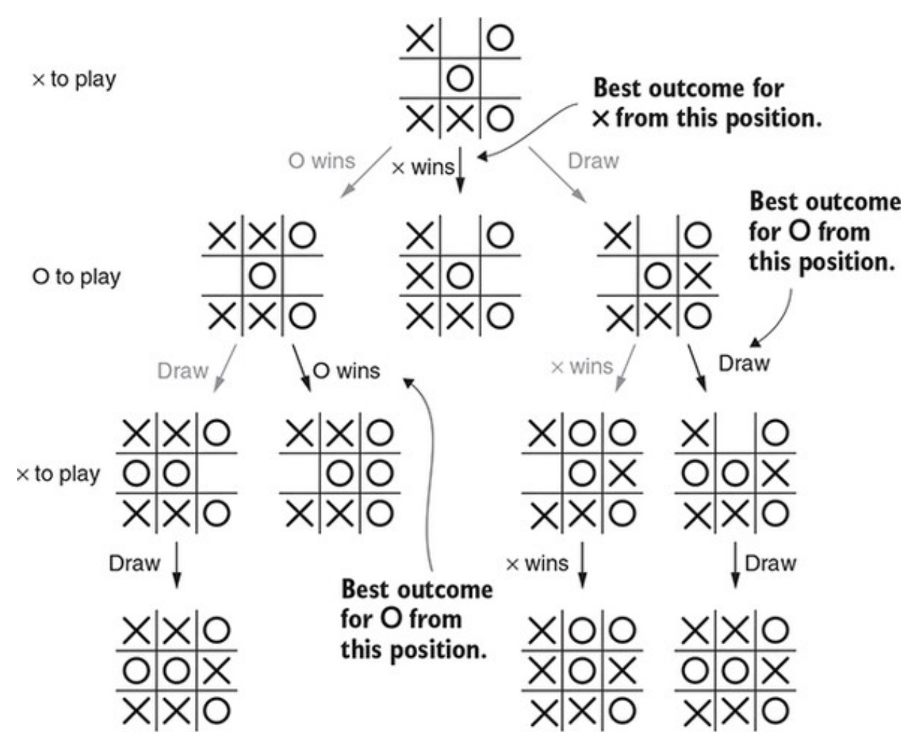
Minimax Agent
Humans play Go by reading ahead
What if your agent read until the end of a game?
Minimax:
You wish to maximize your score
Your opponent wish to minimize your score

Slide 7
Depth-pruned Agent
Go is too complicated to read till the end
Need to prune the tree
Reduce the tree depth
Evaluate your advantages/disadvantages during the game
 | Branching Factor 30 Chess | Branching Factor 250 Go
After Two Moves | 900 | 62500
After Three Moves | 27000 | 15 Million
After Four Moves | 810,000 | 4 Billion
After Five Moves | 24 Million | 1 Trillion!!

Slide 8
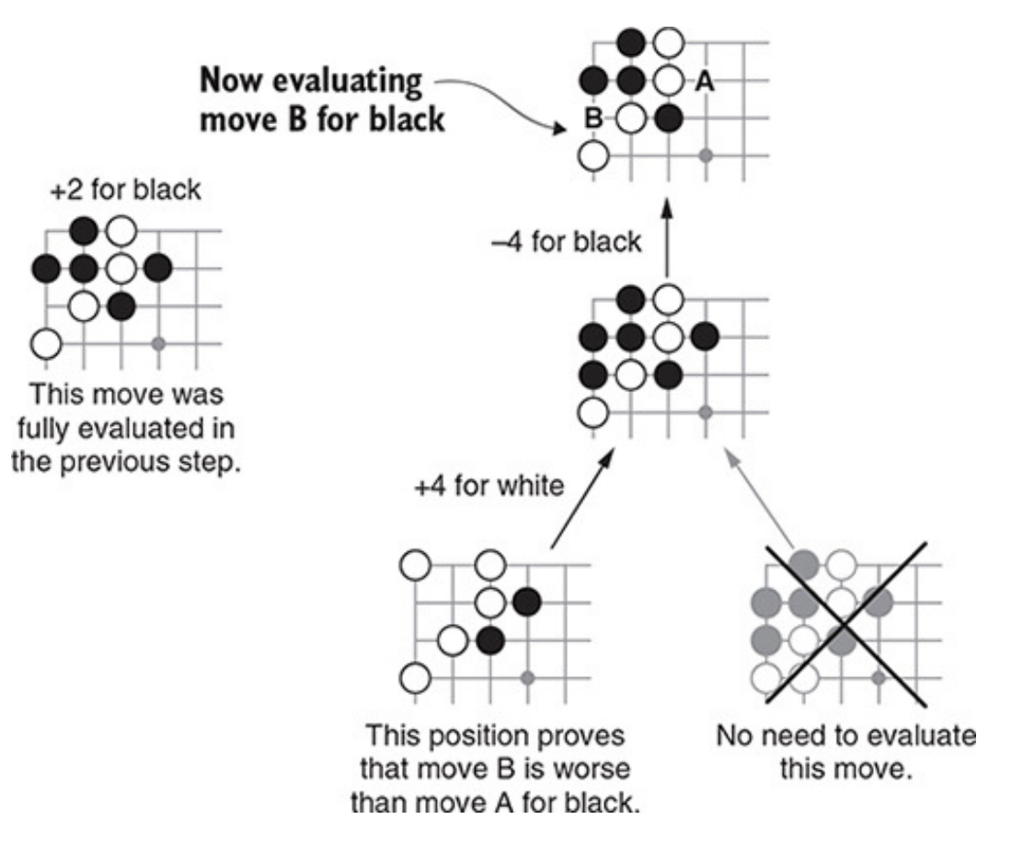
AlphaBeta Agent
Also reduce width of the tree
If a branch is good/bad enough, stop searching
Alpha: best score for Black; Beta: best score for White

Slide 9
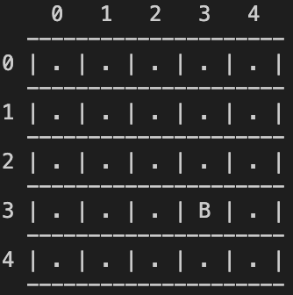
Gameplay: MCTS agent vs. Random agent
Black: MCTS
White: Random
Starting move is quite random

Slide 10
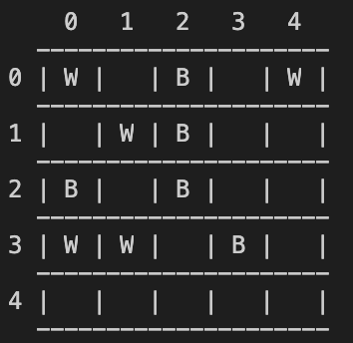
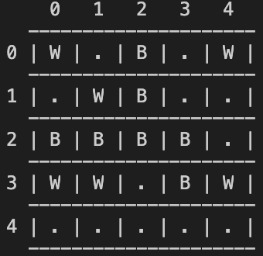
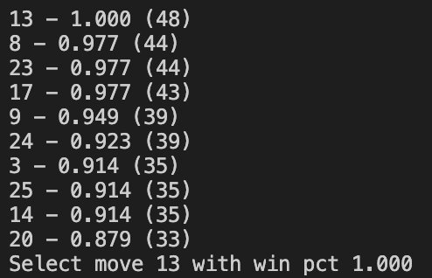
Gameplay: MCTS agent vs. Random agent
Black: MCTS
White: Random
Select the move with highest win chance
Vital position

Slide 11
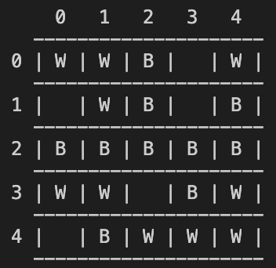
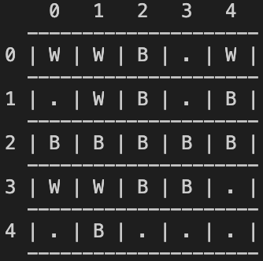
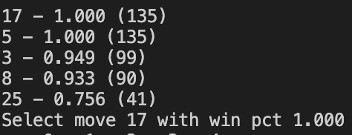
Gameplay: MCTS agent vs. Random agent
Black: MCTS
White: Random
Select the move with highest win chance
Kills 4 stones

Slide 12
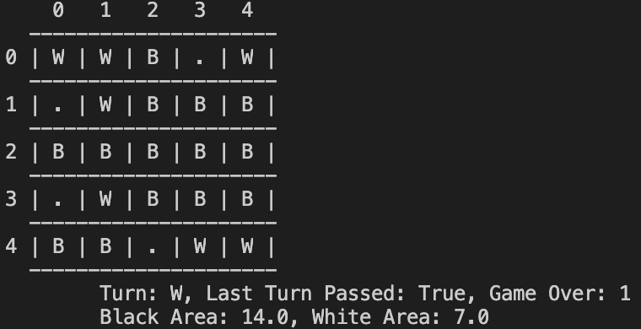
Gameplay: MCTS agent vs. Random agent
Black: MCTS
White: Random
Final board

Slide 13
Week 5: What do we plan to do next?
Finalise the interface for the game agents
Try to zero-down on a ui tool and integrate with the interface
Learning from historical game plays -- standing on the shoulders of giants
Continue researching on algorithms
NN
Q learning

